Slide 1












Social Science Data Modeling with R

Slide 2


About Me
Elijah Appiah from Ghana.
Ph.D. Economics at NIDA in Bangkok, Thailand.
Economist by profession and Data Scientist by passion.
Enthusiastic about working with data daily.
Technical skills in LATEX, Microsoft Office (Word, Excel, PowerPoint), SPSS, Stata, EViews, Python, R, Power BI, Tableau, and Google TensorFlow.
Augustine Otobi Ogbaji from Nigeria.
Postgraduate student at University of Calabar and a Faculty at SICSS.
Data Science and Machine Learning Engineer.
Passionate about Artificial Intelligence.

Slide 3
Importance of Data Modeling in Social Science
Test and develop theories.
Predict and forecast future social trends and phenomena.
Understand complex relationships among variables.
Generate new hypothesis and research questions.
Assess impact of social policies and interventions.
Encourages data-driven decision-making.
Communicate research findings.

Slide 4
IDE and Packages for this Lecture
Main IDE for R is Rstudio
Packages:
Base R Packages | visdat
tidyverse | dlookr
ggplot2 | missRanger
summarytools | gapminder

Slide 5
Outline
Introduction to Data Modeling
Types of Data (Statistics)
Types of Data (Regression)
Data Cleaning and Preprocessing
Univariate Analysis
Bivariate Analysis
Multivariate Analysis
Correlation Analysis
Regression Analysis
Time Series Analysis

Slide 6
Introduction to Data Modeling - Types of Data
Qualitative Data (Categorical)
Nominal
Names, labels, categories with no natural order
E.g. gender, countries, marital status, etc…
Ordinal
Names, labels, categories with an order.
E.g. Likert Scales (Strongly Disagree, Disagree, Neutral, Agree, Strongly Agree)
Quantitative Data (Numeric)
Discrete
Measures of variables that can be counted.
E.g. number of students, number of passengers in a vehicle, number of SICSS participants, etc…
Continuous
Measured on a continuum, or within an interval.
E.g. height, weight, temperature, etc…

Slide 7
Types of Data in Regression
Cross-Sectional Data
Data collected at a single point in time from different individuals, or subjects.
Time Series Data
Data collected on one or more variables over a series of time intervals or periods, typically at regular intervals.
Panel Data
Consists of both cross-sectional and time series data; data is collected on multiple individuals or subjects over multiple time periods.

Slide 8
Introduction to Data Modeling - Types of Data
Cross-Sectional Data
Linear Regression
Linear Probability Model, Logit, and Probit Models
Ordinal Logit and Probit Models
Multinomial Logit and Probit Models
Instrumental Variable Estimation and Two-Stage Least Squares (2SLS), 3SLS.
Tobit Model
Poisson Regression Model
Heckman Model, etc…
Time Series Data
Autoregressive (AR) Model
Moving Average (MA) Model
ARMA Model
Autoregressive Integrated Moving Average (ARIMA) Model
Seasonal ARIMA Model
Vector Autoregression (VAR)
Autoregressive Distributed Lag (ARDL) Model, etc…
Panel Data
Pooled OLS, Fixed Effects, and Random Effects Models
Dynamic Panel Model, etc…

Slide 9
Data Cleaning
Data type conversion
Handling missing data
remove, or
impute – mean, median, mode, predictive modeling
Outlier detection and treatment

Slide 10
Data Cleaning
Data type conversion
Convert character data types to factors.
dplyr::mutate()

Slide 11
Data Cleaning
Handling missing data
dlookr::plot_na_pareto()
visdat::vis_miss()
Remove missing values
data %>% drop_na()
impute – mean, median, mode, predictive modeling
dlookr::imputate_na()
missRanger::missRanger()

Slide 12

Now, let’s practice

Slide 13
Univariate Analysis – Introduction
Meaning
Analyze a single variable.
Relevance
Helps understand the nature of a single variable.
Distribution
Central tendency
Variability

Slide 14
Univariate Analysis – Descriptive Statistics
Categorical
Frequency Distribution Table
Numeric
Measures of Central Tendency
Mean, Mode, Median
Measures of Dispersion/Spread
Range, Variance, Standard Deviation, Interquartile Range
Other Measures
Skewness, Kurtosis, Coefficient of Variation (CV), etc…

Slide 15
Univariate Analysis – Descriptive Statistics
install.packages(“summarytools”)
library(summarytools)
Categorical
Frequency Distribution Table
freq()
Numeric
Measures of Central Tendency
Measures of Dispersion
Other Measures
descr()

Slide 16
Now, let’s practice

Slide 17
Univariate Analysis – Data Visualization
Categorical
Bar plot
Numeric
Histogram
Density plot
Box plot
Dot plot
Frequency polygon

Slide 18
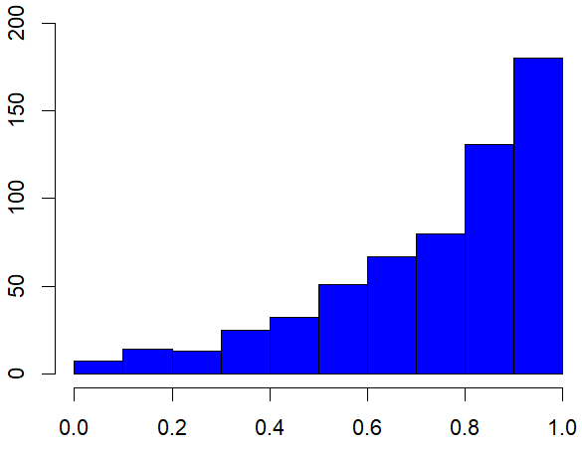
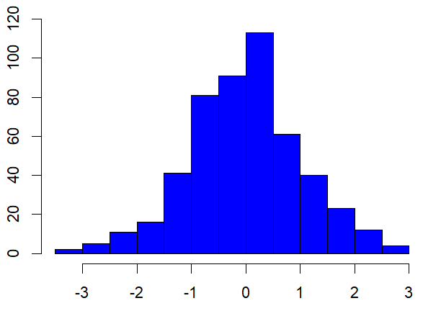
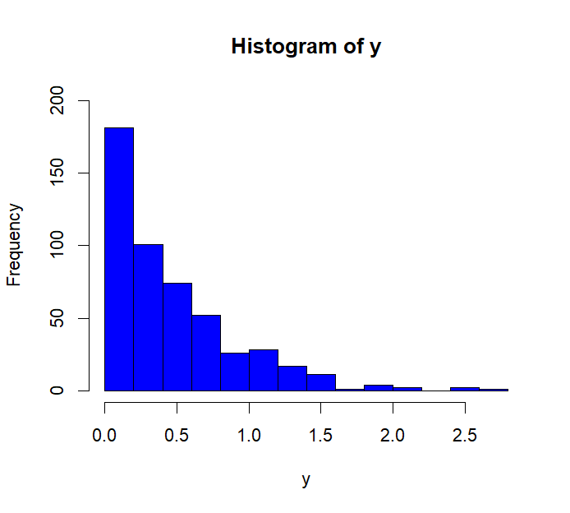
Univariate Analysis – Data Visualization (Histogram)
Left-skewed
Symmetric
Right-skewed

Slide 19

Univariate Analysis – Data Visualization (Histogram)
Symmetric
The mean and median are (approximately) equal in a symmetric or normal distribution.

Slide 20
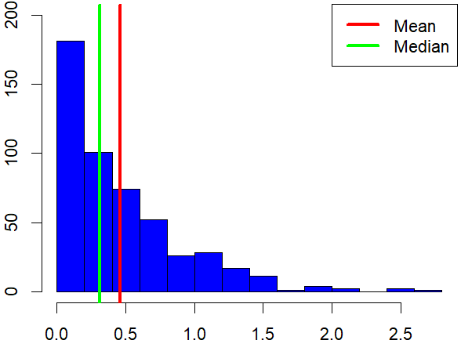
Univariate Analysis – Data Visualization (Histogram)
Right-skewed
The mean is sensitive to extreme values, and thus, the median is more robust in a skewed distribution. The mean is pulled towards the skew or extreme values.

Slide 21
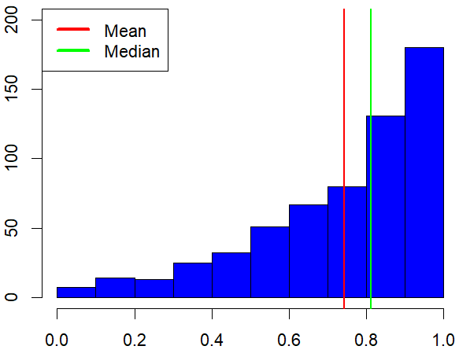
Univariate Analysis – Data Visualization (Histogram)
Left-skewed
The mean is sensitive to extreme values, and thus, the median is more robust in a skewed distribution. The mean is pulled towards the skew or extreme values.

Slide 22
Now, let’s practice

Slide 23
Univariate Analysis – Variability or Spread
Numeric
Range
Maximum value – Minimum value
Very sensitive to outliers or extreme values, making it an unreliable measure of spread.
Variance
Dispersion of data points around the mean.
Average squared deviation from the mean.
Sensitive to outliers: outliers with large deviations from the mean inflate the variance.

Slide 24
Univariate Analysis – Variability or Spread
Numeric
Standard Deviation
Dispersion of data points around the mean.
Average deviation from the mean.
Sensitive to outliers: outliers with large deviations from the mean inflate the standard deviation.
Interquartile Range (IQR)
Difference between 3rd and 1st quartiles (Q3 – Q1).
Less sensitive to extreme values and skewed data because it considers the middle 50% of the data and less influenced by the extreme values in the tails of the distribution.
Which is robust?
In a symmetric/normal distribution, the standard deviation is just the measure to go for.
In a skewed distribution, the IQR is robust.

Slide 25
Now, let’s practice

Slide 26
Bivariate Analysis – Introduction
Meaning
Explores the relationship between two variables.
Relevance
Identify relationships.
Assessing correlations (statistical significance).
Test causal relationships through hypothesis.

Slide 27
Bivariate Analysis – Assessing Relationships
Two Numeric Variables
Scatter Plot
Correlation
Two Categorical Variables
Contingency Table
Chi-squared Test
One Numeric, One Categorical
Box Plot / Violin Plot
T-test / ANOVA

Slide 28
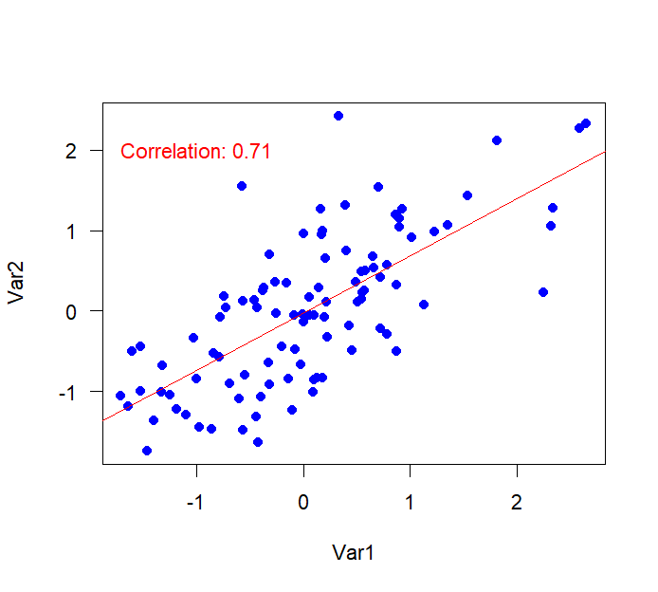
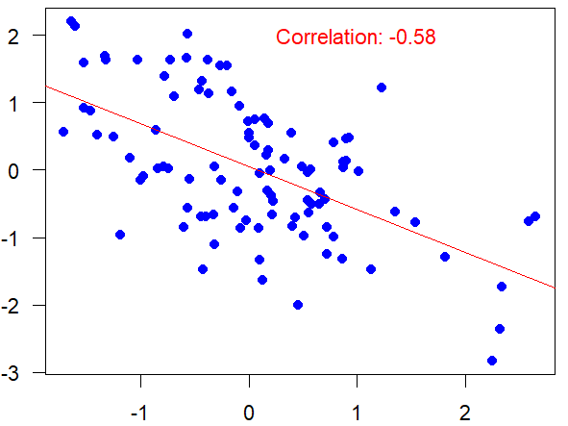
Bivariate Analysis – Assessing Relationships (Numeric)
Positive Relationship
Negative Relationship

Slide 29
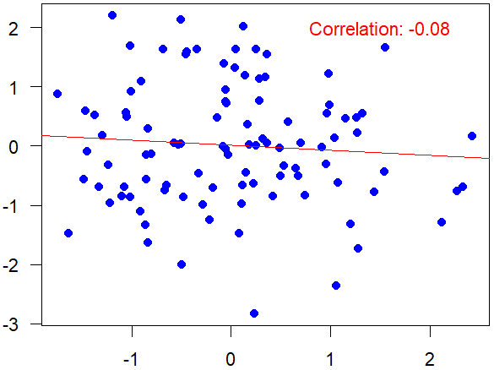
Bivariate Analysis – Assessing Relationships
Almost No Relationship

Slide 30
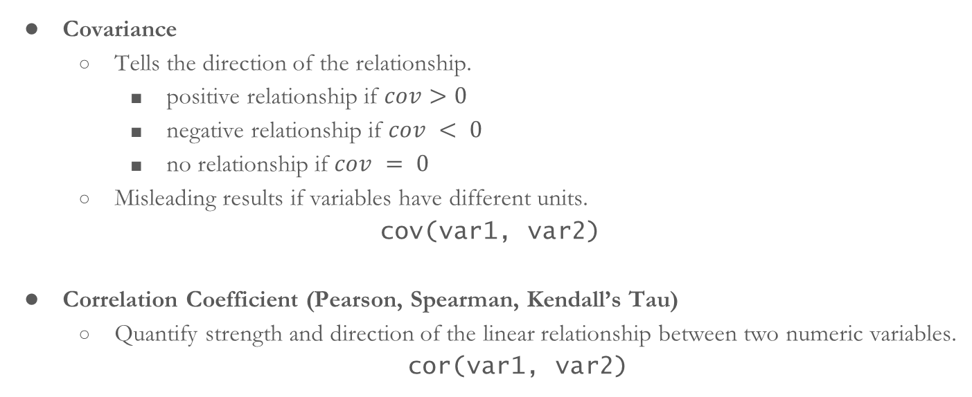
Bivariate Analysis – Assessing Relationships
Covariance
Tells the direction of the relationship.
positive relationship if $cov>0$
negative relationship if $cov < 0$
no relationship if $cov = 0$
Misleading results if variables have different units.
cov(var1, var2)
Correlation Coefficient (Pearson, Spearman, Kendall’s Tau)
Quantify strength and direction of the linear relationship between two numeric variables.
cor(var1, var2)

Slide 31
Bivariate Analysis – Assessing Relationships
Correlation Coefficient
Quantify strength and direction of the linear relationship between two numeric variables.

Slide 32
Bivariate Analysis – Assessing Relationships
Types of Correlation Coefficients:
Pearson Product-Moment Correlation Coefficient or Pearson Correlation Coefficient.
Spearman Correlation Coefficient (Spearman’s rho)
Kendall’s Tau Correlation Coefficient

Slide 33

Bivariate Analysis – Assessing Relationships
Statistical Significance of the Correlation Coefficient
Formulate the Hypothesis:
$$H_{0}:r=0$$
$$H_{1}:r≠0$$
cor.test(x, y)
(Correlation is not different from zero)

Slide 34
Now, let’s practice

Slide 35
Bivariate Analysis – Assessing Relationships (Categorical)
Analyzing the relationship between two categorical variables typically involves creating contingency tables and conducting chi-squared tests.
Contingency Table
Construct a table that cross-tabulates the two categorical variables.
Each cell shows the count/frequency of observations in each combination of categories.
summarytools::ctable(var1, var2)
Chi-squared Test
Chi-squared test of independence.
Assesses whether the observed frequencies differ significantly from what would be expected if the variables were independent.
table(var1, var2)
chisq.test(table)

Slide 36
Now, let’s practice

Slide 37
Bivariate Analysis – One Numeric, One Categorical
Involves exploring differences in numeric values across different categories.
Data Visualization
Box plot/ Violin plot
T-Test
Test whether there are statistically significant differences in means between the numeric variable across the categories of the categorical variables.
t.test(nvar1 ~ cvar2)
ggstatsplot::ggbetweenstats()

Slide 38
Now, let’s practice

Slide 39
Multivariate Analysis – Introduction
Meaning
Statistical technique used to analyze data with multiple variables simultaneously.
Relevance
Gain deeper insights into complex datasets.
Uncover hidden patterns in data.
Explore relationships between variables.
Dimensionality reduction.

Slide 40
Multivariate Analysis – Types
Principal Component Analysis (PCA)
Reduces high-dimensional data while preserving variance.
Identifies important variables or patterns.
Factor Analysis
Identifies latent factors explaining correlations.
Cluster Analysis
Groups data points based on similarities.
Examples: K-means, Hierarchical clustering.

Slide 41
Multivariate Analysis – Types
Multivariate Analysis of Variance (MANOVA)
Extends ANOVA to multiple dependent variables.
Assesses significant group differences with multiple response variables.
Structural Equation Modeling (SEM)
Models complex relationships among observed and latent variables.
Combines factor analysis and regression to test causal hypotheses.

Slide 42
Regression Analysis
Regression is the study of the dependence of one variable (dependent variable) on one or more other variables (independent variable[s]), with the aim of estimating or predicting the mean of the dependent variable based on the known values of the independent variable(s).
“Galton’s Universal Law of Regression”
Find out how the average height of sons changes given the father’s height.
Height of Sons
Fathers’ Height
Dependent Variable
Independent Variable

Slide 43
Regression Analysis – Terminology
Dependent Variable | Independent Variable
Explained Variable | Explanatory Variable
Predictand | Predictor
Regressand | Regressor
Outcome Variable | Covariate
Controlled Variable | Control Variable

Slide 44

Linear Regression Analysis – Simple vs. Multiple
Simple Linear Regression
$$Y=β_{0}+β_{1}X+u$$
Multiple Linear Regression
$$Y=β_{0}+β_{1}X_{1}+β_{2}X_{2}+β_{3}X_{3}+…+u$$
Height of Sons
Fathers’ Height
Height of Sons
Fathers’ Height
Mothers’ Height
Nutrition

Slide 45
Assumptions of Classical Linear Regression Model
There is no perfect relationship between the independent variables.
The variance of the error term is constant or homoscedastic.
There is no autocorrelation between the error terms.
What if these assumptions are violated?
Multicollinearity
It inflates the variance – regression coefficients cannot be estimated with great precision [Variance Inflation Factor (VIF)].
Heteroscedasticity
Incorrect standard errors, and unreliable tests of significance.
Autocorrelation
Incorrect standard errors, and unreliable tests of significance.

Slide 46
Linear Regression Analysis – Problem
Nature of Variables
Dataset
Car Resale Data - 2023 from Kaggle
lm(formula, data)
Source: https://www.kaggle.com/datasets/rahulmenon1758/car-resale-prices
Dependent Variable | Independent Variable(s)
Continuous | Numeric or categorical

Slide 47
Now, let’s practice

Slide 48
LPM, Logit and Probit Models
The dependent variable is binary.
Examples:
Yes or No (0 = No, 1 = Yes)
Health Outcome (0 = Not Cured, 1 = Cured)
Votes (0 = NPP, 1 = NDC)
Patient Satisfaction of Healthcare (0 = Satisfied, 1 = Not Satisfied)

Slide 49
LPM, Logit and Probit Models
The dependent variable is binary.
Examples:
Yes or No (0 = No, 1 = Yes)
Votes (0 = NPP, 1 = NDC)
Patient Satisfaction of Healthcare (0 = Satisfied, 1 = Not Satisfied)
Approaches to Measuring Binary Outcome Variables
Linear Probability Model (LPM)
Logit or Logistic Regression Model
Probit (or Normit) Model

Slide 50
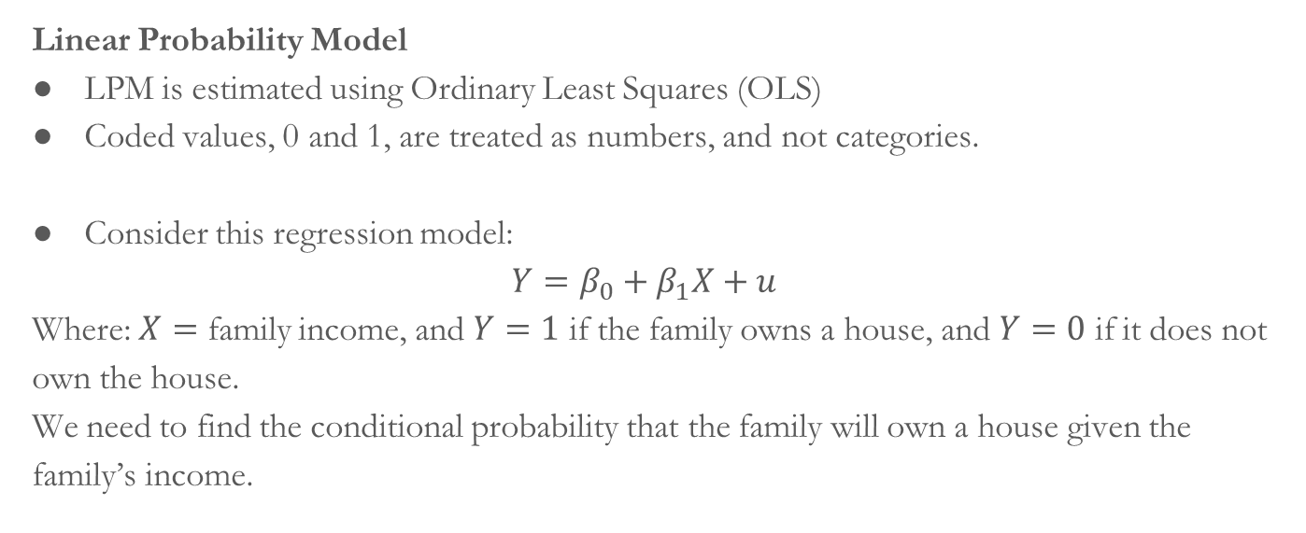
LPM, Logit and Probit Models
Linear Probability Model
LPM is estimated using Ordinary Least Squares (OLS)
Coded values, 0 and 1, are treated as numbers, and not categories.
Consider this regression model:
$$Y=β_{0}+β_{1}X+u$$
Where: $X=$ family income, and $Y=1$ if the family owns a house, and $Y=0$ if it does not own the house.
We need to find the conditional probability that the family will own a house given the family’s income.

Slide 51
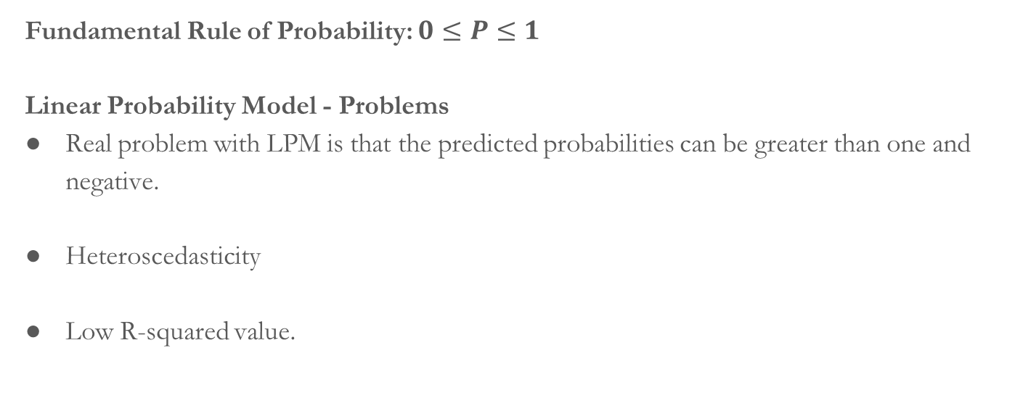
LPM, Logit and Probit Models
Fundamental Rule of Probability: $0≤P≤1$
Linear Probability Model - Problems
Real problem with LPM is that the predicted probabilities can be greater than one and negative.
Heteroscedasticity
Low R-squared value.

Slide 52
LPM, Logit and Probit Models
How do we get around the problems of LPM – probability rule violation?
Estimate the LPM by the usual OLS
method. If estimated Y has some values
less than 0 [i.e. negative], Y is assumed
to be zero for those cases; if they are
greater than 1, they are assumed to be 1.
Constrained LPM
Devise an estimating technique that will
guarantee that the estimated conditional
probabilities Y will lie between 0 and 1.
Logit and Probit Models

Slide 53
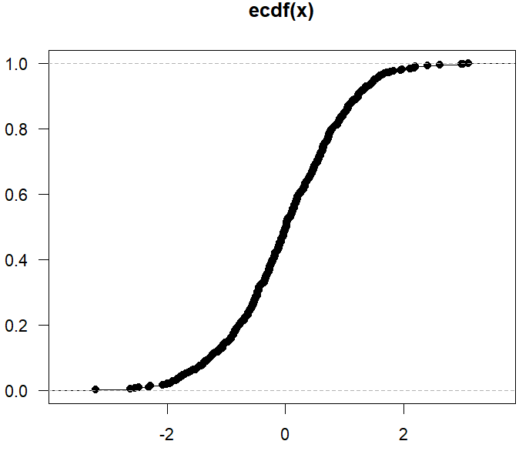
LPM, Logit and Probit Models
Logit and Probit Models
Cumulative distribution functions (CDF)
are sigmoid, or s-shaped.
Some CDFs are the logistic CDF (logit) and standard normal CDF (probit).

Slide 54
LPM, Logit and Probit Models
Match
Win
Win
Win
Win
Lose
Lose
Lose
Lose
Lose
Lose
A scenario
Match | Frequency
Win | 4
Lose | 6
What can we do with count data?
What is the PROBABILITY that a team wins a match?
What are the ODDS of winning the match?

Slide 55


LPM, Logit and Probit Models
Probability is the number of events divided by the total outcome.
Match | Frequency
Win | 4
Lose | 6
$$prob=\frac{4}{10}=0.40$$
Odds are the chances of something happening to something not happening.
$$odds=\frac{4}{6}=0.67$$

Slide 56
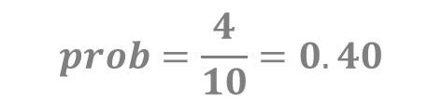
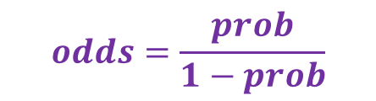
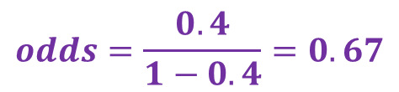

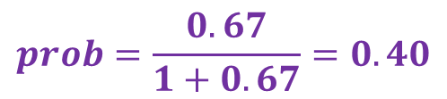
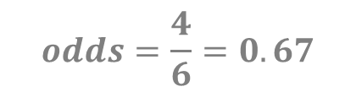
LPM, Logit and Probit Models
Probability is odds can be expressed in terms of each other.
$$prob=\frac{odds}{1+odds}$$
$$odds=\frac{prob}{1−prob}$$
$$prob=\frac{4}{10}=0.40$$
$$odds=\frac{4}{6}=0.67$$
$$prob=\frac{0.67}{1+0.67}=0.40$$
$$odds=\frac{0.4}{1−0.4}=0.67$$

Slide 57
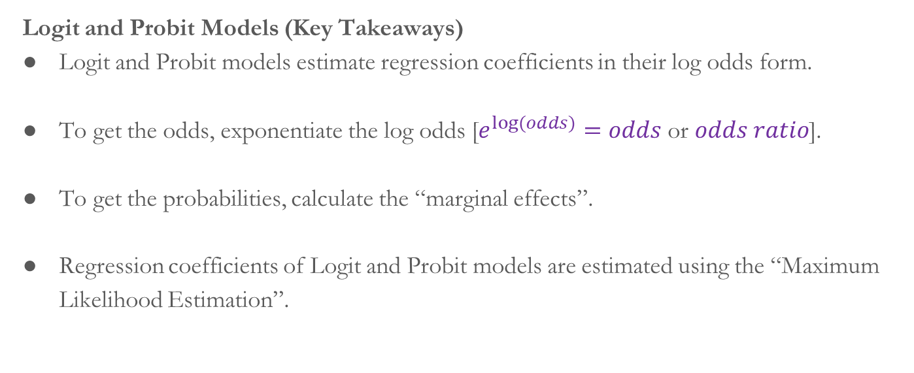
LPM, Logit and Probit Models
Logit and Probit Models (Key Takeaways)
Logit and Probit models estimate regression coefficients in their log odds form.
To get the odds, exponentiate the log odds [$e^{log⁡(odds)}=odds$ or $odds ratio$].
To get the probabilities, calculate the “marginal effects”.
Regression coefficients of Logit and Probit models are estimated using the “Maximum Likelihood Estimation”.

Slide 58
LPM, Logit and Probit Models
Nature of Variables
Dataset
Employee Dataset from Kaggle
glm(formula, family, data)
mfx::logitmfx()
mfx::probitmfx()
Source: https://www.kaggle.com/datasets/tawfikelmetwally/employee-dataset
Dependent Variable | Independent Variable(s)
Categorical (only 2 categories) | Numeric or categorical

Slide 59
Now, let’s practice

Slide 60
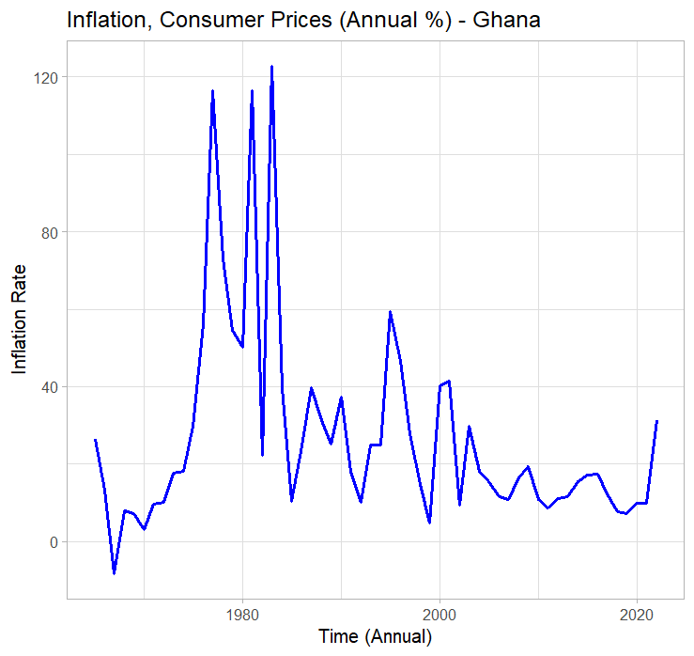
Time Series Analysis - Introduction
Time Series is chronological
sequence of data recorded over time.
The basic assumption is that
observations are evenly spaced.

Slide 61
Time Series Analysis – Time Series Objects in R
The ts() function is used to create a time series object.
ts(data, start, end, frequency)
The is.ts() function whether an object is of the ts() class.
is.ts()

Slide 62
Now, let’s practice

Slide 63
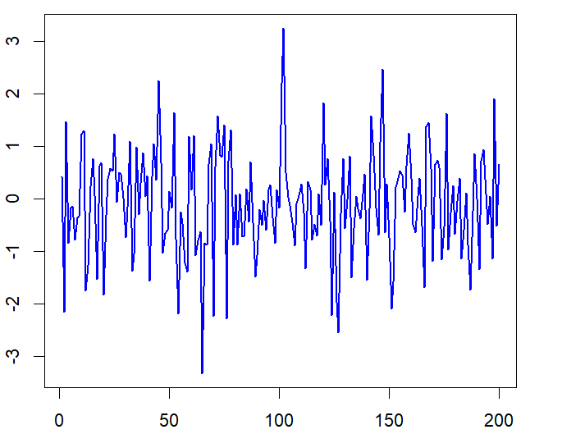
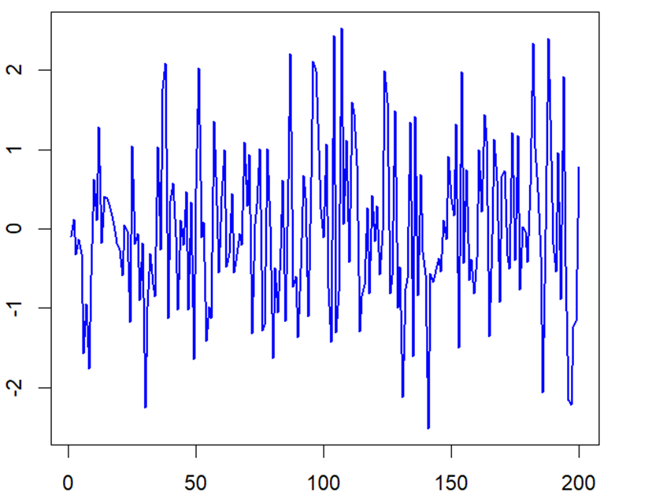
Time Series Analysis - Trends
Some time series do not exhibit any trend.

Slide 64
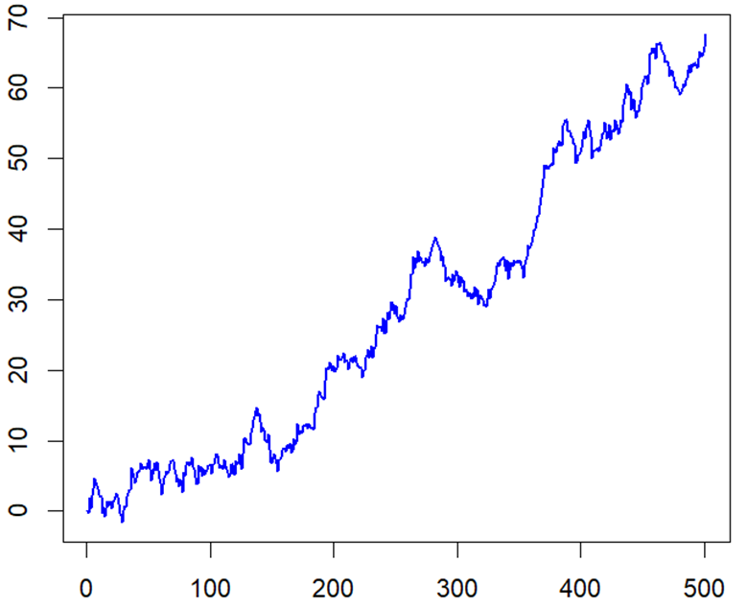
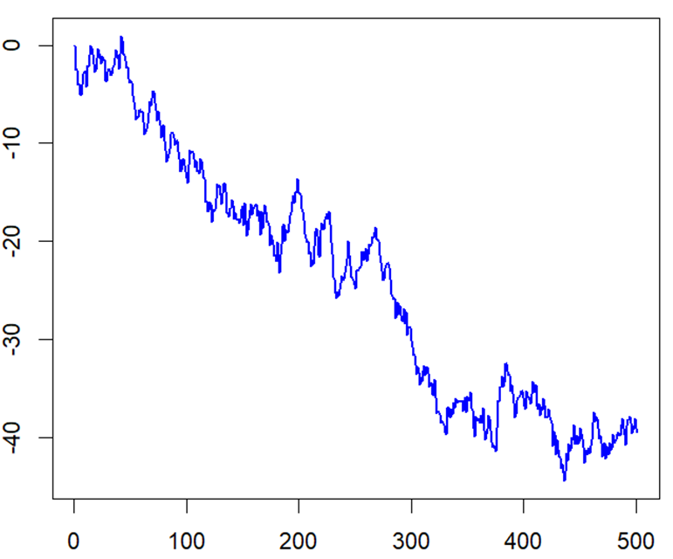
Time Series Analysis - Trends
Some time series exhibit linear trends over time.

Slide 65
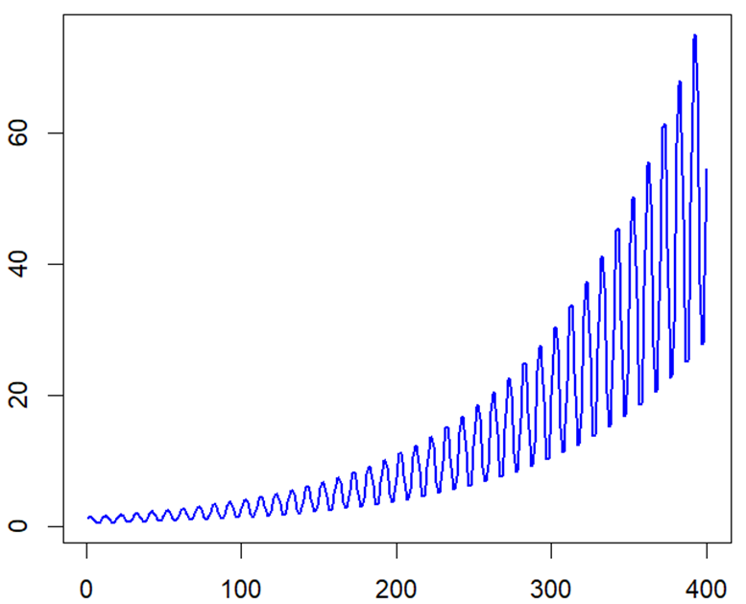
Time Series Analysis - Trends
Some time series exhibit rapid growth trends over time.

Slide 66
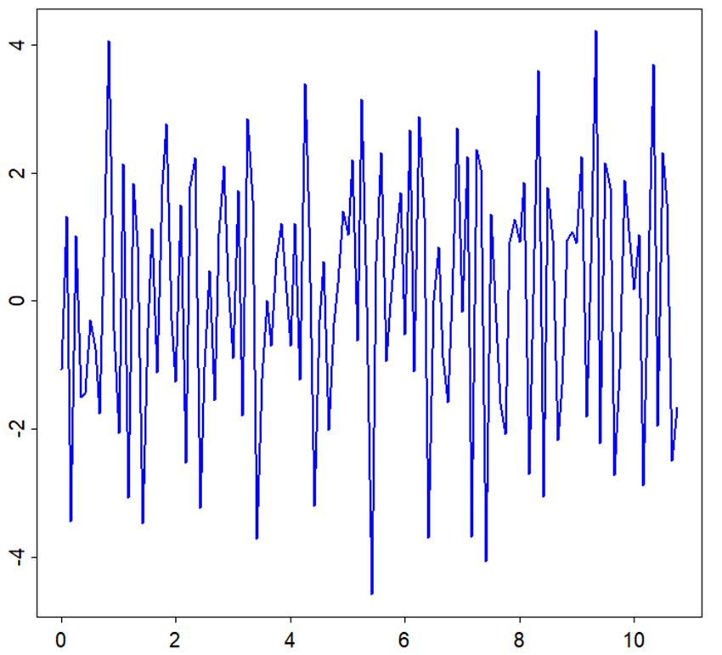
Time Series Analysis - Trends
Some time series exhibit periodic trends over time.

Slide 67
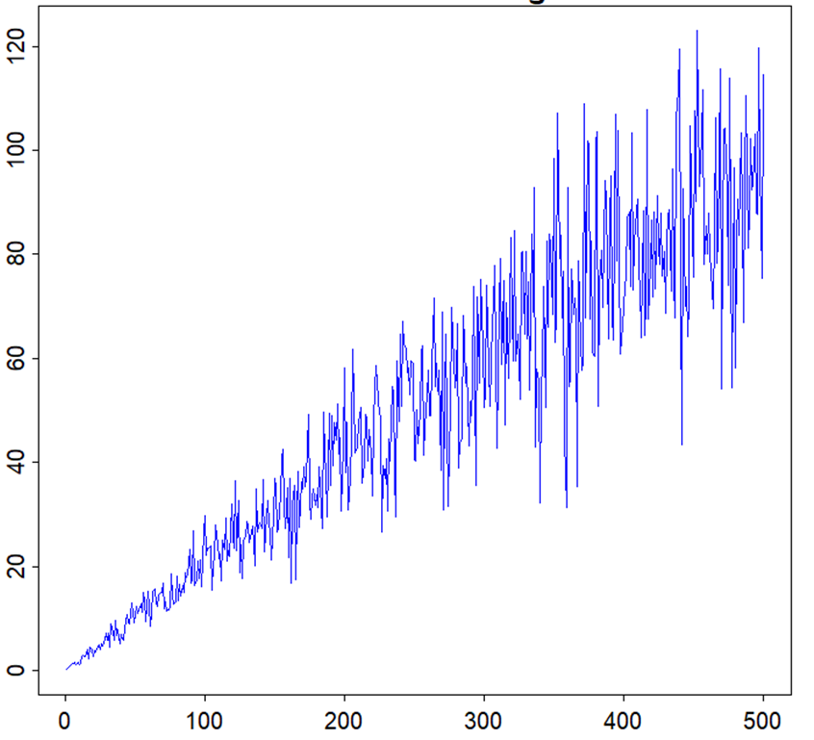
Time Series Analysis - Variance
Some time series exhibit increasing variance over time.

Slide 68
Time Series Analysis – Basic Time Series Models
White Noise (WN)
Random Walk (RW)
Autoregression (AR)
Simple Moving Average (MA)

Slide 69
THANK
YOU

